Slide 1






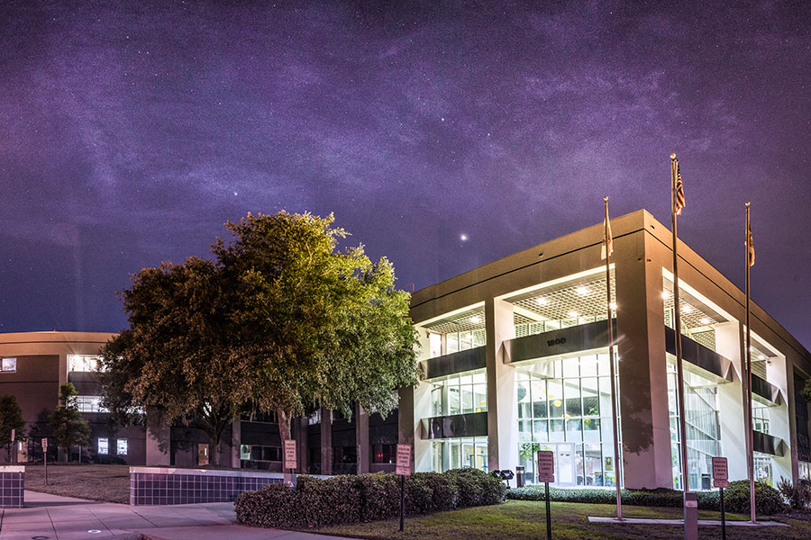

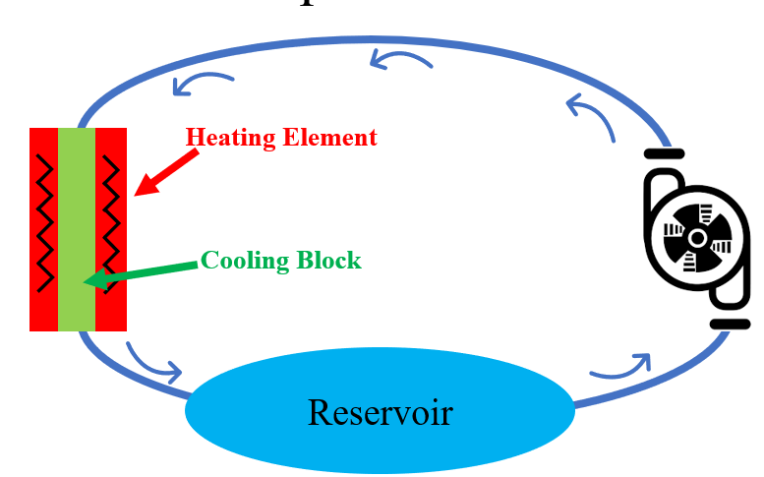
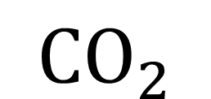
Reducing Carbon Emission in the Innovation Park
Team 517: Bianca Marius | Finnbar Rooney | Nicholas Walker
Company Sponsor: Cameron Griffith | Academic Advisor: Dr. Juan Ordonez
Objective:
Reduce the carbon emissions of the Innovation Park by reducing the energy consumption of the park.
There are three ways Team 517 will accomplish this objective:
Redesign the cooling system for the magnets at the MagLab.
Move chill water from the MagLab to IRCB.
Create a tabletop validation technique to test the theory.
$${CO}_{2}$$
MagLab
IRCB
Carbon emissions are a byproduct of burning fossil fuels to produce electricity
The validation technique will be a cooling loop to simulate cooling a magnet based on voltage used
Our plan will cool the magnets based on the power that they use. This will ensure that they are not overcooled and wasting energy.
Cooling the water at the MagLab and transporting it to IRCB will take advantage of the MagLab’s efficient cooling system and save energy.

